Slide 1
CT Project Bi-Weekly Status Report
Jack Xu Oct 19, 2020

Slide 2
Accomplishments
Completed transmitting code from GCP to AWS
Completed test from end to end
Tested AWS accessibility in China
Studied Android testing and checked testing related code from other android Open source projects
Did market research about Contact Tracing applications on Google/Apple watches.

Slide 3
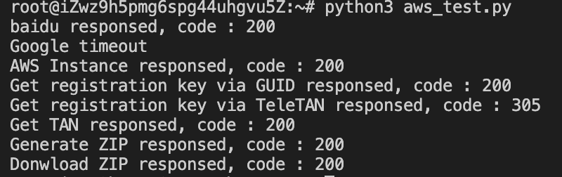
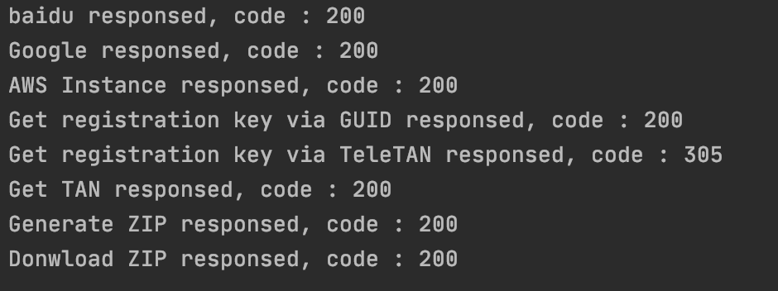
AWS Accessibility
AliCloud EC2, located in China
My computer, located in US

Slide 4
Some errors encountered along the way
Invoke URL in API Gateway:
In GCP, invoke URL can be used directly.
In AWS, the actual URL should combine this invoke URL and stage
Response from the server:
In GCP, status code can be returned together with payload using common (e.g. return payload, 200)
In AWS, we need return { 'statusCode': 200, 'body’: payload}
Download file from server:
In GCP, this can be done using Google’s SDK
In AWS, no naïve approach is available. I then switched to implement it using Java

Slide 5
Learning test codes from other Android open source projects
HMS Open Source:
Few Tests included
Focus on show how easy it is to adopt one service
Google Open Source:
Detailed test case for important functions/scenarios included
Focus on illustrating Google’s Best Practice
Use Kotlin as code, Jetpack as framework
Kirk’s advice:
Write a test plan before testing
Focus on Unit test first

Slide 6
Market study about Contact Tracing on wearable devices
Whether there are existing/possible Contact Tracing applications on Google/Apple watches?
Google/Apple watch
Singapore solution
2. Whether it is technically possible for developers to implement such watch applications?
Ability to broadcast Bluetooth signals
3. How can we make it possible? What Huawei have now? What are the missing parts?
Use case and system diagram
Bluetooth broadcast and scan
Data synchronization
Research did for all three parts, still tracking

